Slide 1
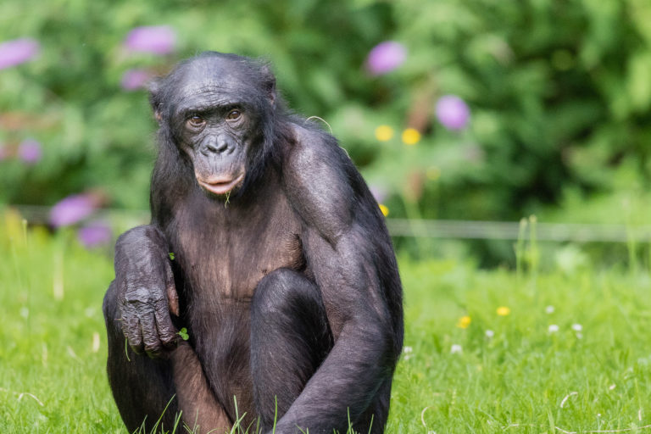
Bonobo
By Coach Sattler

Slide 2
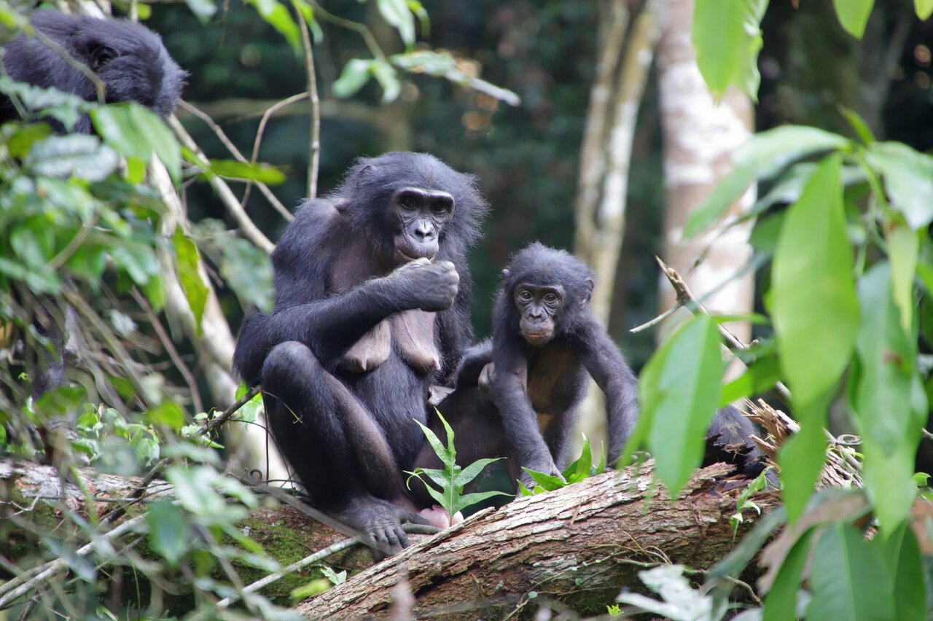
Introduction to Bonobo
Scientific Name
Taxonomy
Evolution
Nutrition
Location
How they are endangered
How to preserve the species
Fun facts

Slide 3
Scientific Name

Slide 4
Taxonomy

Slide 5
Evolution

Slide 6
Nutrition

